Slide 1

DOBBS ELEMENTARY
Notes:
Good Morning/Afternoon! Today we begin the process of planning our school’s budget for FY23. I know we are all here for the same reason and that is ensuring success for all (enter school name) students. This meeting is to provide an overview of the draft budget and for you to give feedback on the draft budget.

Slide 2




NORMS
This is a meeting of the GO Team. Only members of the team may participate in the discussion. Any members of the public present are here to quietly observe.
We will follow the agenda as noticed to the public and stay on task.
We invite and welcome contributions of every member and listen to each other.
We will respect all ideas and assume good intentions.

Slide 3



GO TEAM BUDGET DEVELOPMENT PROCESS
YOUR SCHOOL STRATEGIC PLAN…
is your roadmap and your role.
It is your direction, your priorities, your vision, your present, your future.
Step 1: Data Review
Step 2: Strategic Plan Review
Step 3: Budget Parameters
(Strategic Priorities)
Step 4: Budget Choices
Notes:
Today I will provide an overview of the budget allocations for FY23. We will begin the work of funding the strategic priorities we agreed upon during our strategic review meeting. (IF YOU HAVE NOT DECIDED ON YOUR PRIORITIES, YOU WILL SAY – WE WILL DECIDE ON OUR PRIORITIES AND THEN DISCUSS ALLOCATING FUNDS TO ADDRESS THOSE PRIORITIES).

Slide 4
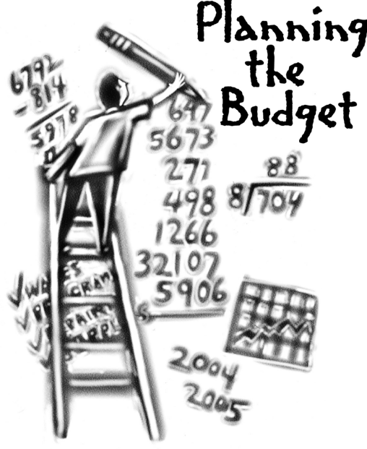
Overview of FY ‘24 GO Team Budget Process
Step 7 GO Team Final Budget Approval Meeting
Budgets Approved by March 17
Step 6 Principals: HR Staffing Conferences Begin
Late February – Early March
Step 5
GO Team Feedback Session: Draft Budget Presented & Discussed February – multiple meetings, if necessary
Step 4 Principals: Associate Supt. Discussions and Review
February (supports needed, specific challenges, coaching)
Step 3 GO Team Initial Budget Session: Allocation
January 24 – early February
Step 2 Principals: Workshop FY 24 Budget
January 24
Step 1 Review and Update Strategic Plan and Rank Strategic Priorities
By end of Fall Semester
GO Teams are encouraged to have ongoing conversations

Slide 5
Budget Allocation Meeting
What
The first GO Team meeting is when the principal will provide an overview of the budget allocation for GO Team members and the general public.
Why
This meeting provides an opportunity for the principal and GO Team to ensure alignment on the school’s key strategic priorities, gain a deeper understanding of the budget allocation, and provide input to drive the direction of the draft budget.
When
End of January- Early February

Slide 6
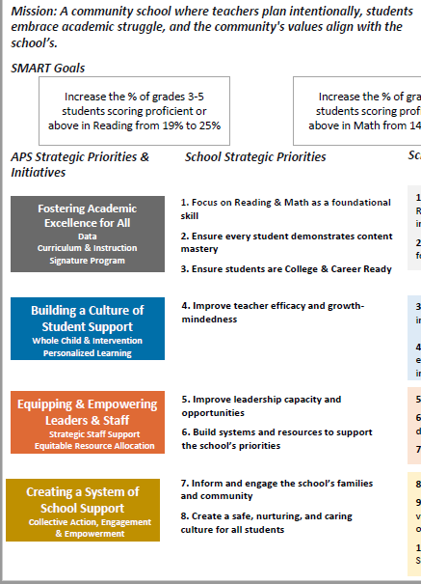
FY24 BUDGET DEVELOPMENT PROCESS
Principal’s Role
Design the budget and propose operational changes that can raise student achievement
Flesh out strategies, implement and manage them at the school level
Focus on the day-to-day operations
Serve as the expert on the school
Hire quality instructional and support personnel
The GO Team’s Role
Focus on the big picture (positions and resources, not people)
Ensure that the budget is aligned to the school’s mission and vision and that resources are allocated to support key strategic priorities

Slide 7
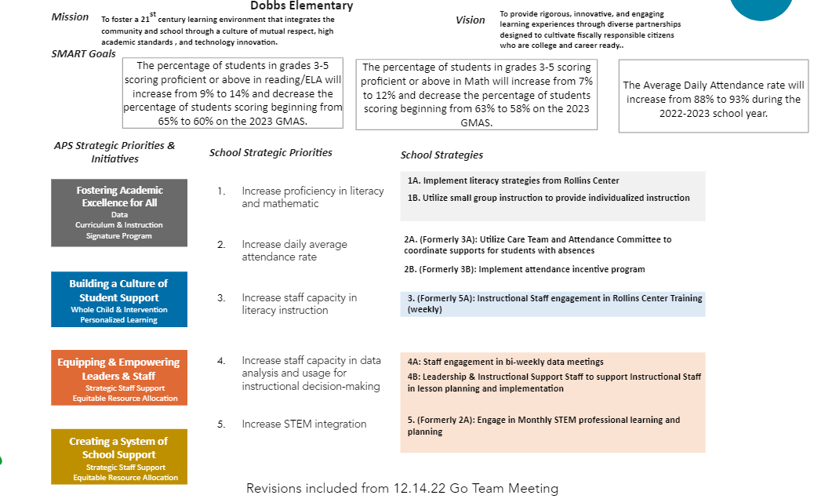

Slide 8

FY24 Budget Parameters
FY24 School Priorities | Rationale
Increase STUDENT proficiency in Literacy and Mathematics | Strategic Plan Goals Increase the # of Teachers for Targeted, small group Instruction
Increase STAFF capacity in literacy instruction. | Increase # of support staff supporting teachers Increase Principal Support to free up time for Instruction Focus
Increase Staff capacity in data analysis and usage for instructional decision making. | There is a need for enhanced teacher support to be able to assist teachers with data analysis that will impact student learning
Notes:
Review the priorities that the GO Team has developed and the rationale for these priorities. Feel free to copy this slide if you have more than 3 priorities to account for.

Slide 9
FY24 Budget Parameters
FY24 School Priorities | Rationale
Utilize data to meet the individual needs of students. | Ensure that students are receiving maximized opportunities for achievement and remediation daily.
Monitor the communication to parents of students chronically absent. | Absent students affect the CCRPI score and adversely impact achievement.
Notes:
Review the priorities that the GO Team has developed and the rationale for these priorities.

Slide 10
Discussion of Budget Summary
(Step 4: Budget Choices)

Slide 11




EXECUTIVE SUMMARY
This budget represents an investment plan for our school’s students, employees and the community as a whole.
The budget recommendations are tied directly to the school’s strategic vision and direction.
The proposed budget for the general operations of the school are reflected at $_5,830,040_____
This investment plan for FY24 accommodates a student population that is projected to be _318_ students, which is a increase/decrease of __-9____ students from FY23.
Notes:
Here’s a few highlights for our budget this year – read executive summary

Slide 12
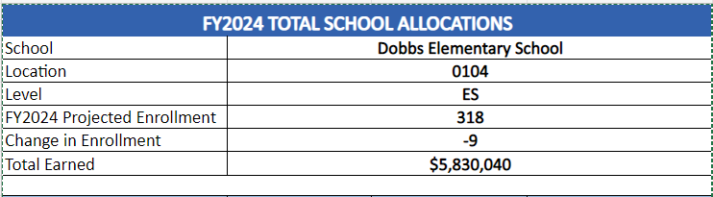
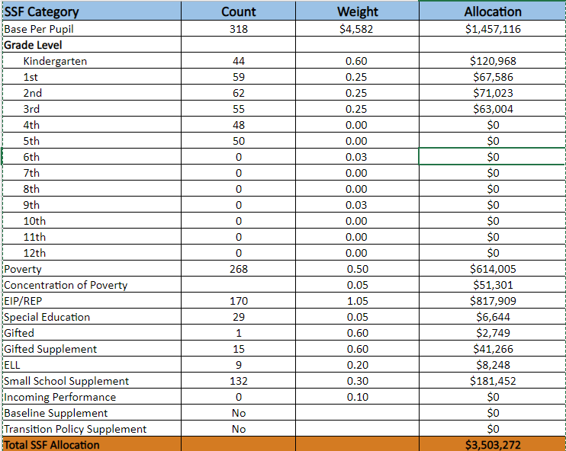
School Allocation
Notes:
For FY23, APS is continuing to increase equity within the District and the flexibility principals have in regards to our schools budgeted funds. The new Student Success Funding Model (SSF) allocates dollars to schools based on the number of enrolled students and receives a funding "weight" based on need. This year, student characteristics were weighted based on:
Grade Level –
K-12
Poverty – Weighted for all Direct Certification enrolled students.
Beginning Performance – Weighted Middle School and High School students entering with beginner’s performance on milestones.
ESOL – Weighted for all ESOL designated students in order to supplement due to ESOL staff being locked.
Special Education - Weighted for all Special Education students.
Gifted – Weighted and measured by number of students in the Gifted Program
Small School Supplement – Weighted for low enrollment schools
ES – 500
MS – 600
HS – 700
As you can see, our projected enrollment for FY23 is _______, we increased/decreased by __________ from last year.
We received the following weights for our student characteristics: (Below is just for the script, principals need to insert their school’s characteristics)
Grade Level
Poverty
Special Education
Gifted
Gifted Supplement
ELL
Small School Supplement

Slide 13
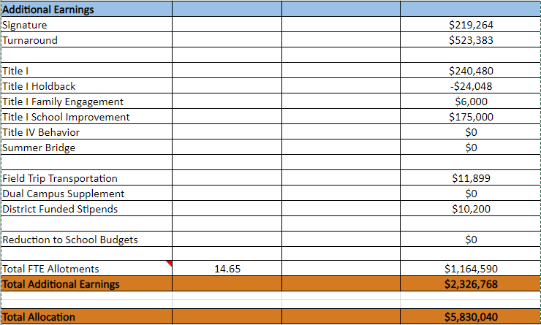
School Allocation
Notes:
Additionally, we received money for signature programming, turnaround, Title I and FTE Allotments.

Slide 14
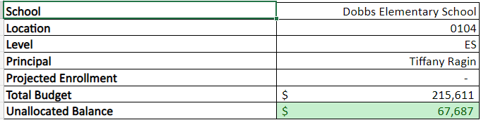
School FY24 CARES Allocation
In addition to a General Fund allocation, our school has been allocated CARES funding that must be used to support implementation of the school-based intervention block and other school-based needs as a result of the COVID-19 Pandemic.
Once the support needed to implement our school-based intervention block/course has been fulfilled, we can use the remaining CARES funds to address other school-based needs that are a result of the COVID-19 Pandemic.
Notes:
Please add your school’s CARES Allocation to this slide.

Slide 15
CARES ALLOCATIONS
OTHER ALLOWABLE CARES EXPENDITURES INCLUDE:
Technology Support: Software, assistive technology, online learning platforms, subscriptions.
Mental and Physical Health: Cover the costs of additional counseling, telehealth, therapeutic services, and wraparound services and supports (contracted hours, professional learning, programs)
Supplemental Learning: Cover costs of remediation, and/or enrichment opportunities during the school year for students (afterschool programs, additional pay for teachers and staff, transportation).
Professional Development: Cover costs of additional professional development for school leaders, teachers, and staff (trainings, extended professional development days, consultants, programs).
At-risk Student Populations: Cover costs of school specific activities, services, supports, programs, and/or targeted interventions directly addressing the needs of low-income students, SWD, racial & ethnic minorities, ELL, migrant & homeless students, and students in foster care.
Continuity of Core Staff and Services. Restore any potential LEA FY22 budget reductions due to decreased state and/or local revenue.

Slide 16
What’s Next?
January
  GO Team Budget Allocation Meeting (Jan. 24th-early February)
February
  One-on-one Associate Superintendent discussions
  Cluster Planning Session (positions sharing, cluster alignment, etc.)
  Program Manager discussions and approvals
  GO Team Feedback Meeting(s) before principal’s staffing conference
  HR Staffing Conferences (Late February)
March
  Final GO Team Approval Meeting (AFTER your school’s Staffing Conference and BEFORE Friday, March 17th)
Notes:
In February, we will meet again to discuss how the school’s budget has been allocated to support the programmatic needs and FY23 key strategic priorities.
If think we need to continue our budget conversations, we will schedule additional meetings. My goal is to make sure your voices are reflected in our school’s budget.
I will also be meeting with my Associate Superintendent, program managers and other key leaders to go over our budget and to make sure the school is meeting the standards of service and appropriately staffing.
During the week of Feb. 24th -March 2nd , HR Staffing Conferences will be held. At this meeting, I will present my plan for staff utilization, resource distribution and plan for staffing implications.
We will need to approve the budget at the ________ meeting.

Slide 17

QUESTIONS?
Thank you for your time and attention.
Notes:
IF YOU FEEL YOUR TEAM IS READY TO APPROVE THE DRAFT BUDGET, PLEASE DO SO. PLEASE REMIND THEM THAT YOU MAY NEED TO MEET WITH THEM AGAIN, IF THERE ARE CHANGES FROM YOUR MEETINGS WITH DISTRICT LEADERSHIP. LET THEM KNOW YOU WILL KEEP THEM INFORMED!!

